Slide 1

Would I Lie to You?
Strapline here
Fake News Facts
How to spot fake news
Why is it dangerous
Some scrolling images/gifs of notable fake news situations
(politics)
(celebrities)
(economics)

Slide 2

Would I Lie to You?
Educate yourself! How woke are you REALLY?
Brexit
Covid
Immigration
Economy
China
Chose subject to enter

Slide 3
Would I Lie to You?
....FAKE NEWS ARTICLE....
TRUE
FALSE
BIAS
CONSPIRACY
...
NEXT

Slide 4
Would I Lie to You?
Answers!
You were wrong...
This article was deemed fake by the FakeNewsCorpus
78% of respondents thought this was real.
Next question

Slide 5
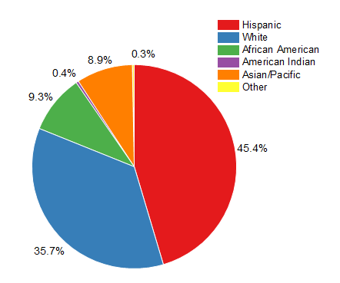
Would I Lie to You?

